Slide 1
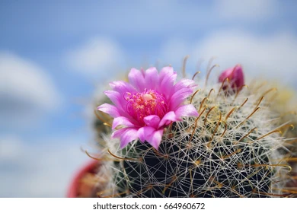
THRIVE
FEARLESSLY
Hot Pink Barrel Cactus

