Slide 1
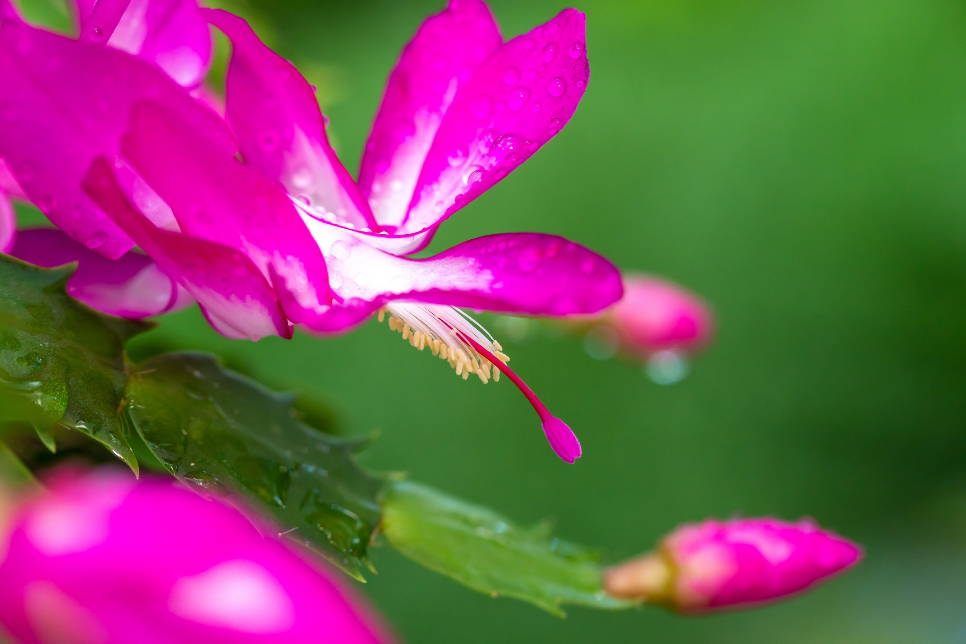
LIVE
AMBITIOUSLY
Christmas Cactus

Slide 2
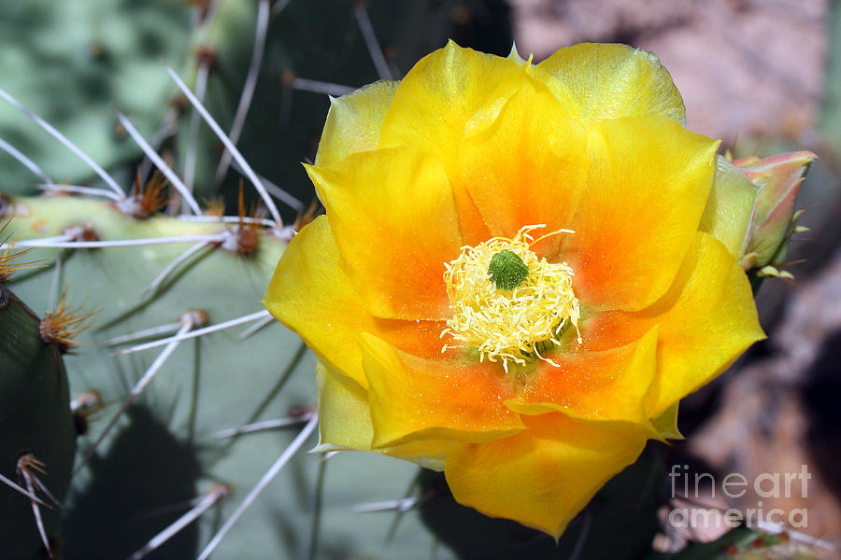
RAISE
RESILIENCE
Yellow Flower Cactus

Slide 3
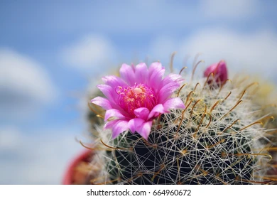
THRIVE
FEARLESSLY
Hot Pink Barrel Cactus

Slide 4
LIVE
AMBITIOUSLY
WORKSHOP
Christmas Cactus

