Slide 1
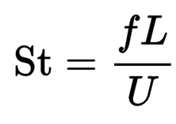
Vortex Shedding
In fluid dynamics, vortex shedding is an oscillating flow that takes place when a fluid such as air or water flows past a bluff body at certain velocities, depending on the size and shape of the body.
In this flow, vortices are created at the back of the body and detach periodically from either side of the body.
The rate at which this happens is the vortex shedding frequency. The Strouhal Number characterizes the frequency of oscillation.

